Slide 1

House Price Estimator
By Aashish Manohar Varlani

Slide 2

Problem Statement
We have to create an estimator which will estimate the price of a house depending on various factors like.
Neighborhood
Lot Area
House Style
Age of the house
Garage Condition
etc

Slide 3
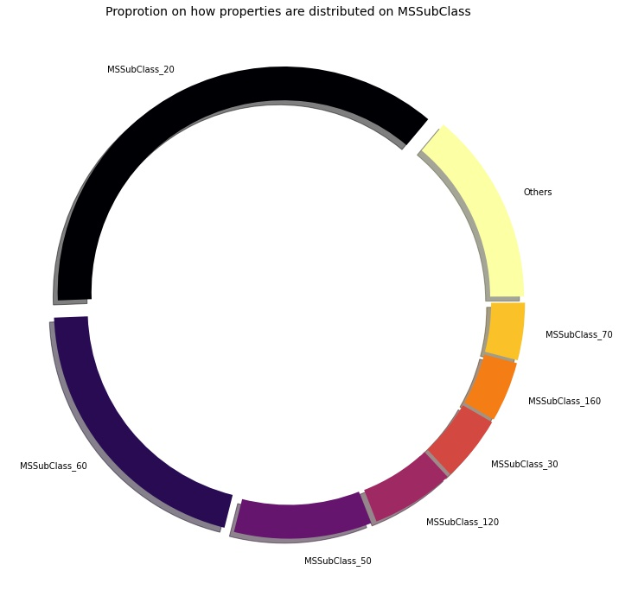

Slide 4
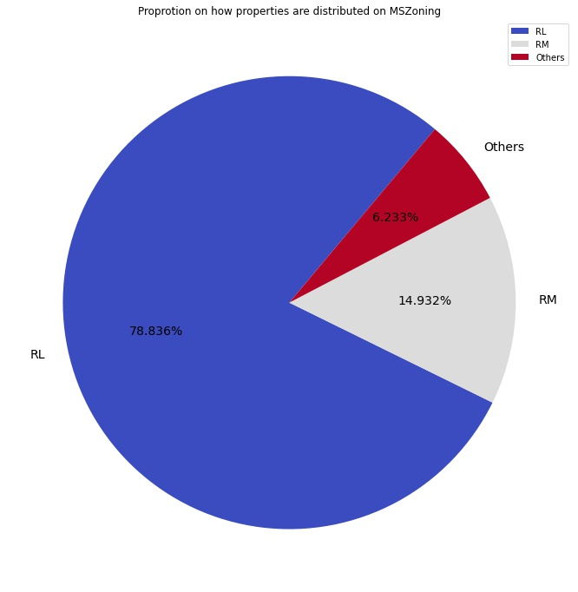

Slide 5
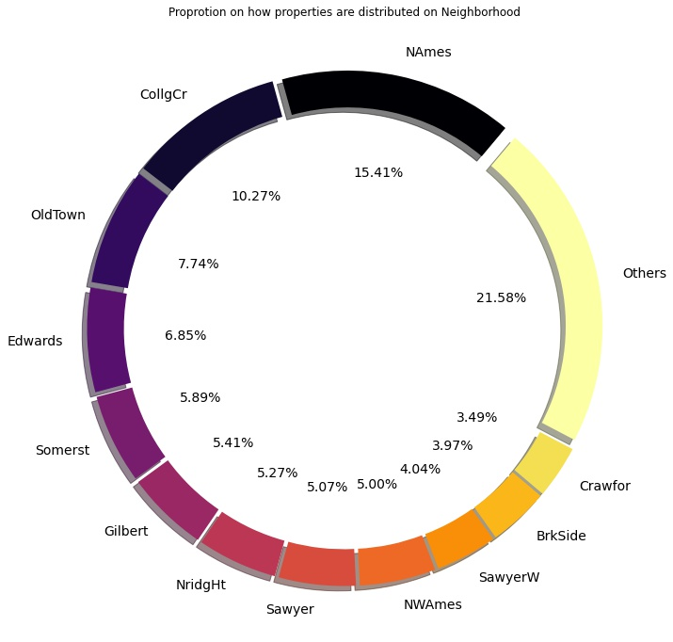

Slide 6
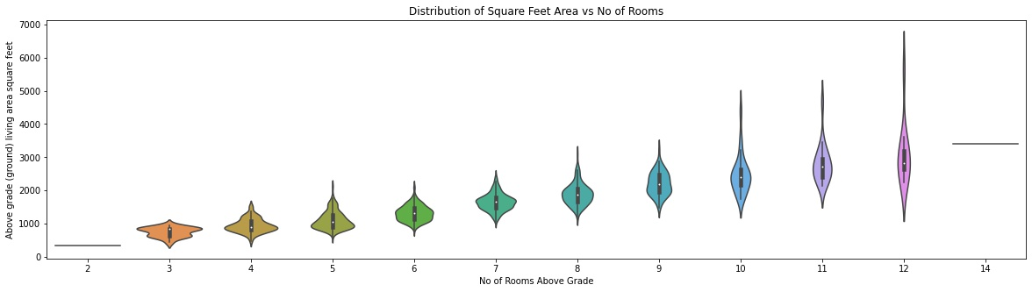

Slide 7
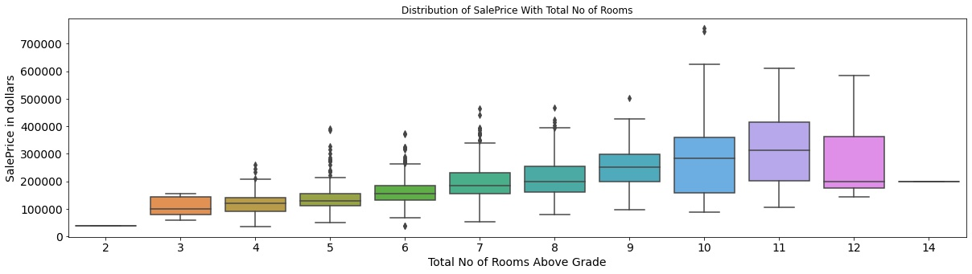

Slide 8
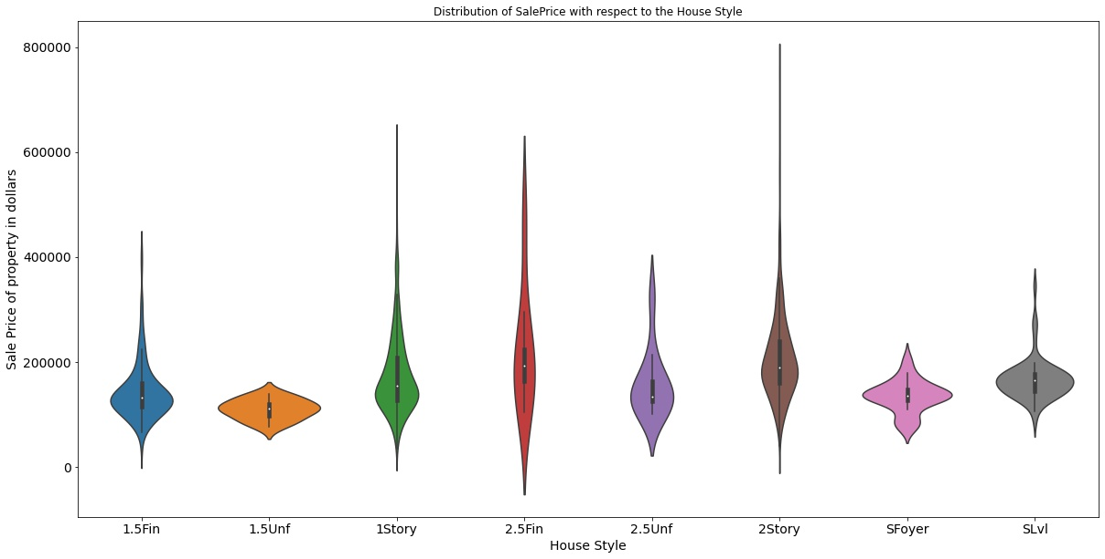

Slide 9
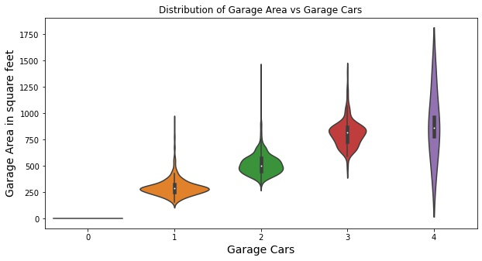

Slide 10
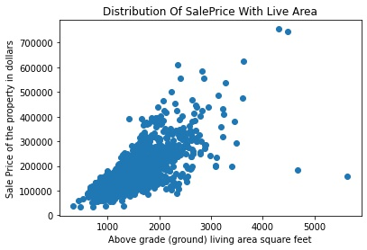
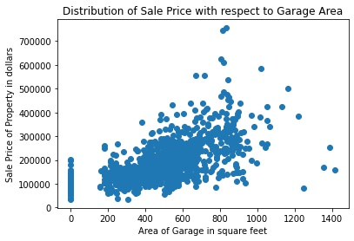
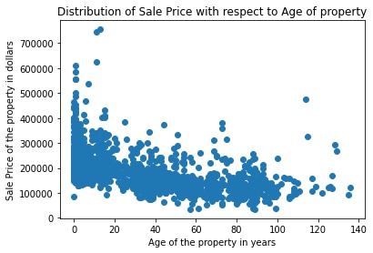
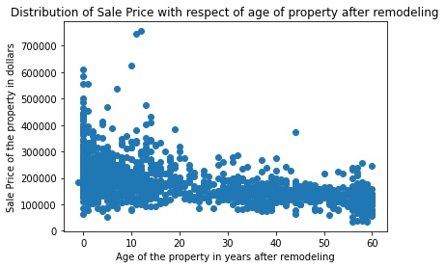
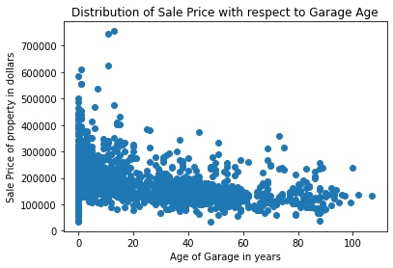

Slide 11
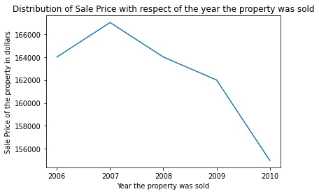

Slide 12
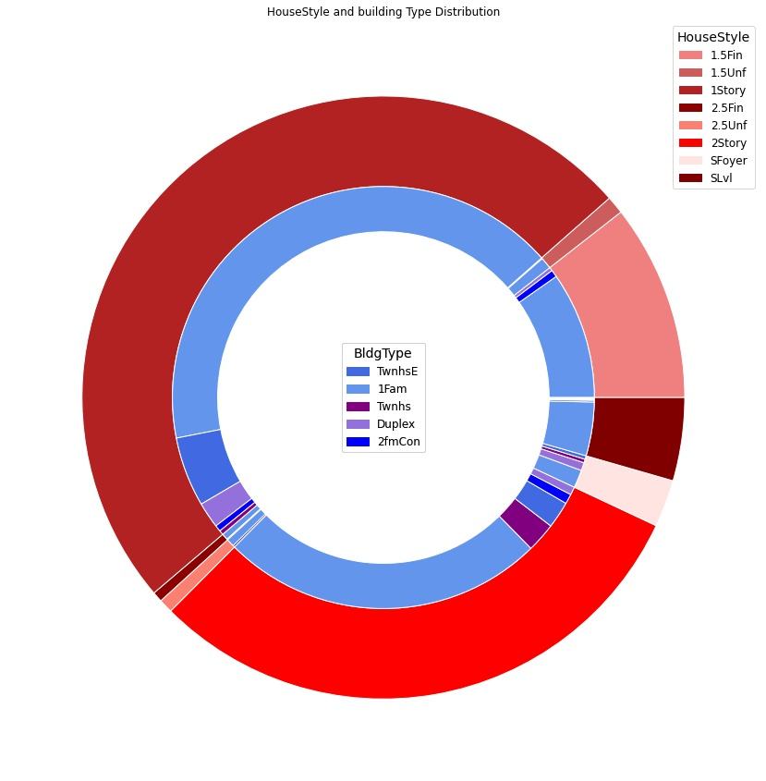

Slide 13
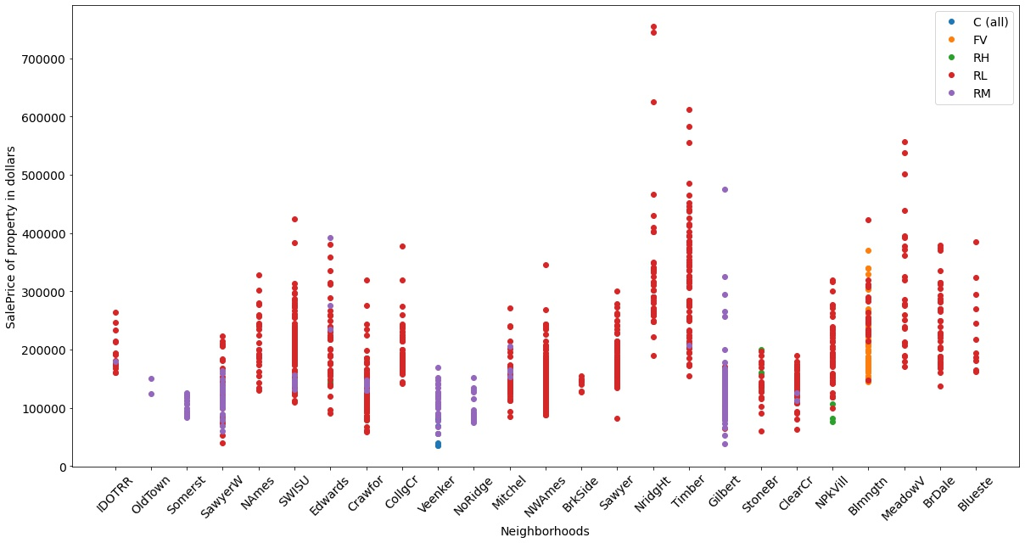

Slide 14
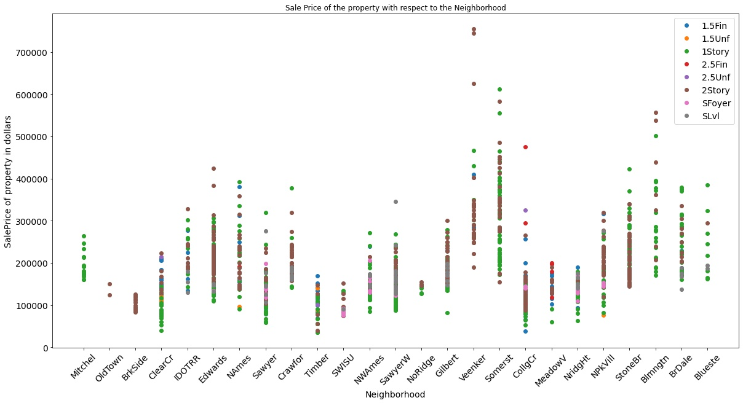

Slide 15
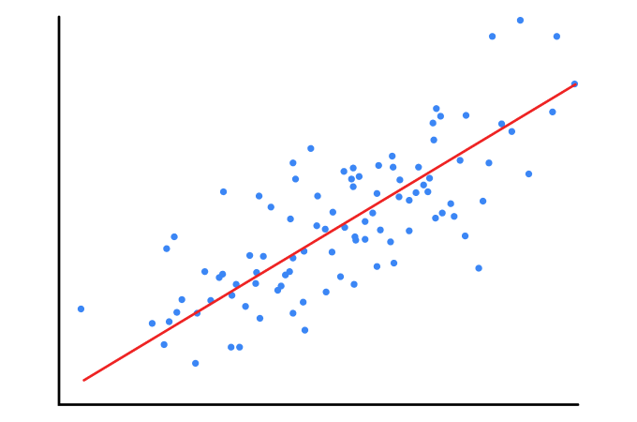
Linear Regression

Slide 16

Prerequisites for Linear Regression

Slide 17
The Target Variable Should be Normally Distributed...

Slide 18
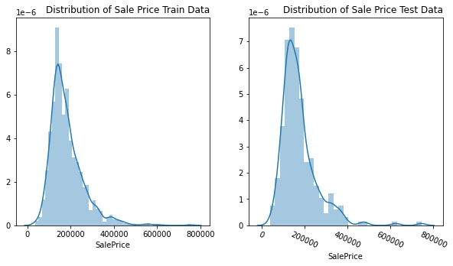
count 1168.000000
mean 182208.341610
std 78086.084388
min 34900.000000
25% 131000.000000
50% 164945.000000
75% 215000.000000
max 755000.000000
Name: SalePrice, dtype: float64
Since The Target Variable is not normally distributed we will apply log transformation

Slide 19
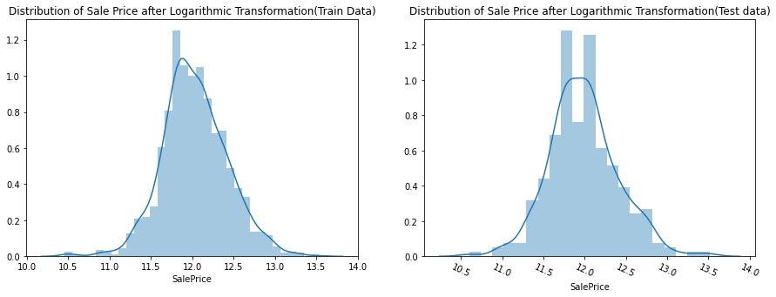
count 1168.000000
std 0.394460
min 10.460242
50% 12.013367
max 13.534473
Name: SalePrice, dtype: float64
mean 12.033654
25% 11.782953
75% 12.278393

Slide 20
There should be a linear relationship between the target variable and the explanatory Variables...

Slide 21
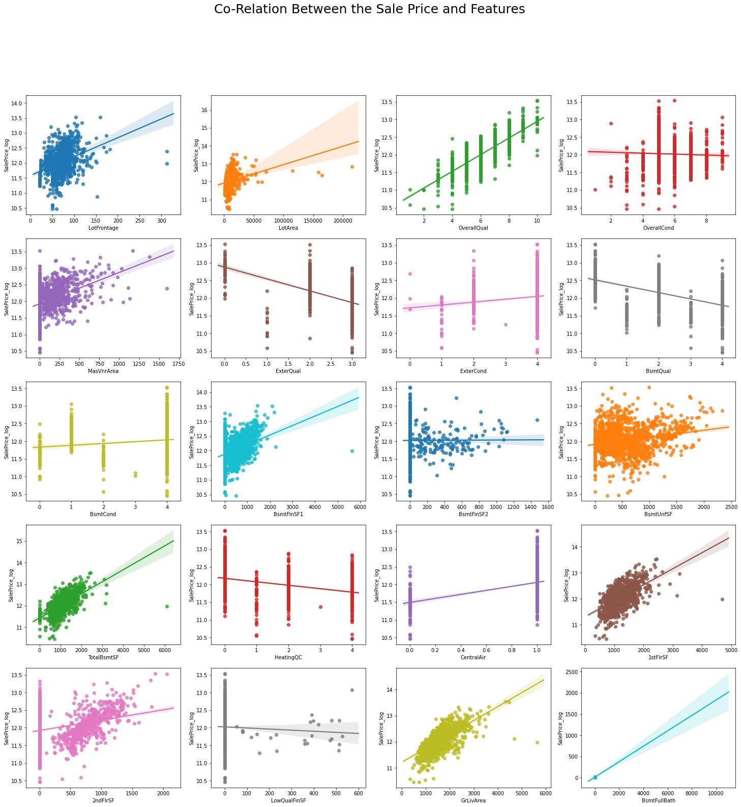

Slide 22
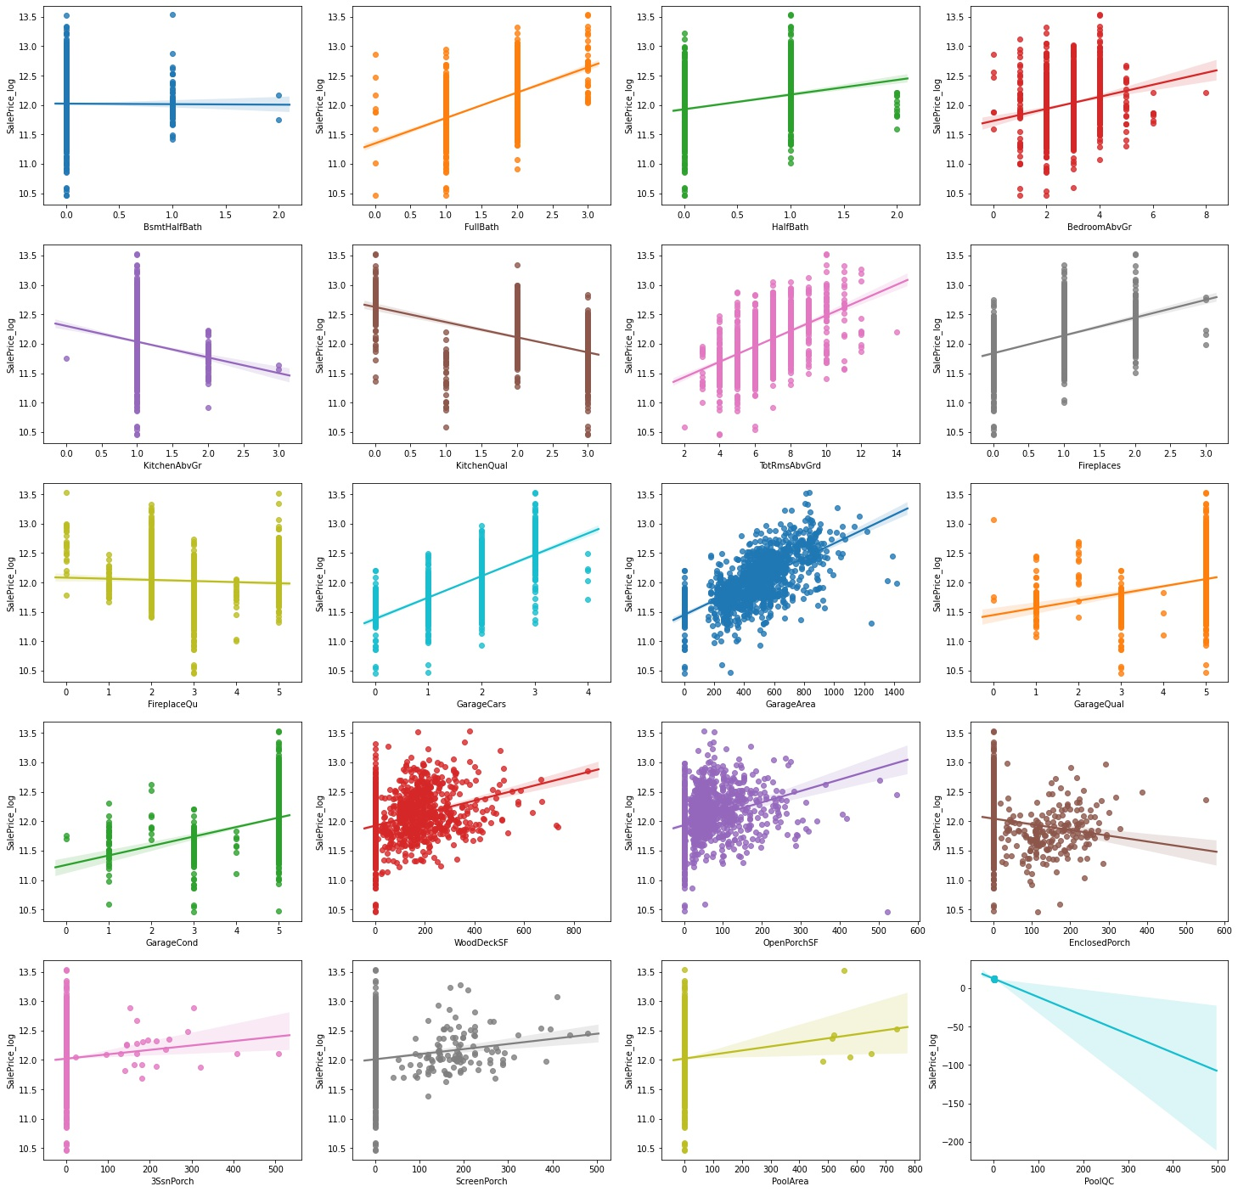

Slide 23
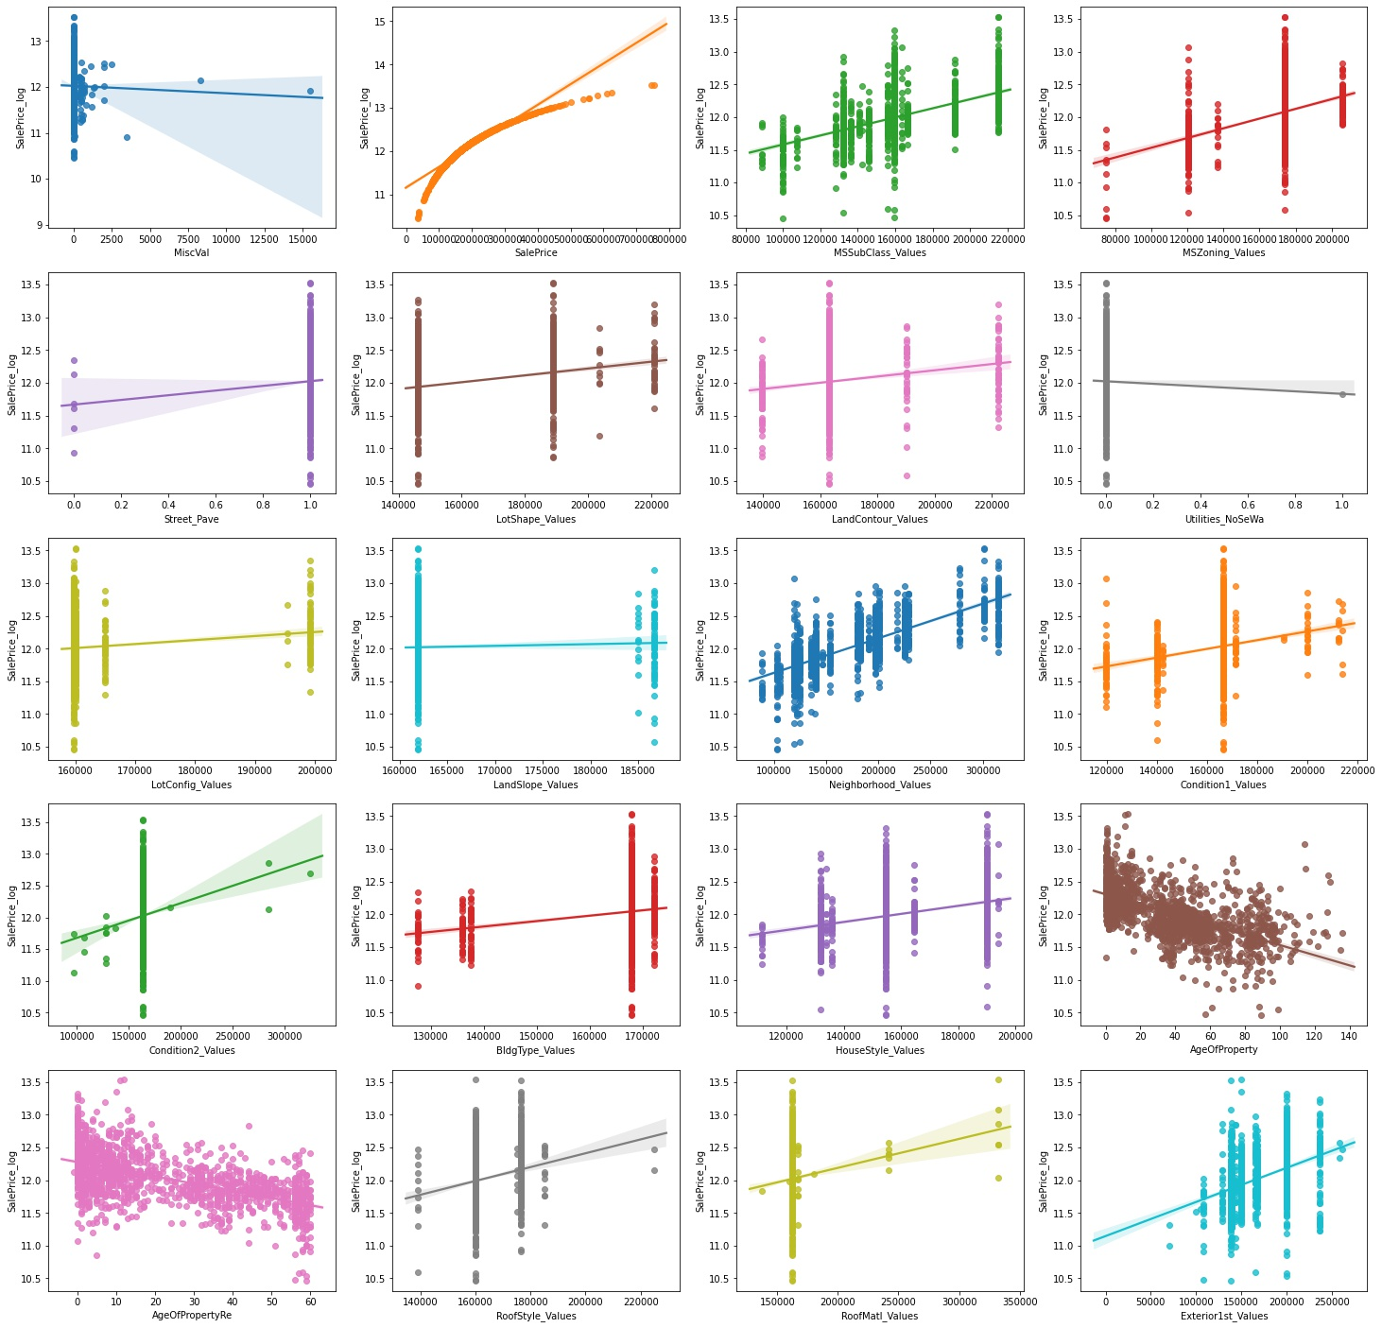

Slide 24
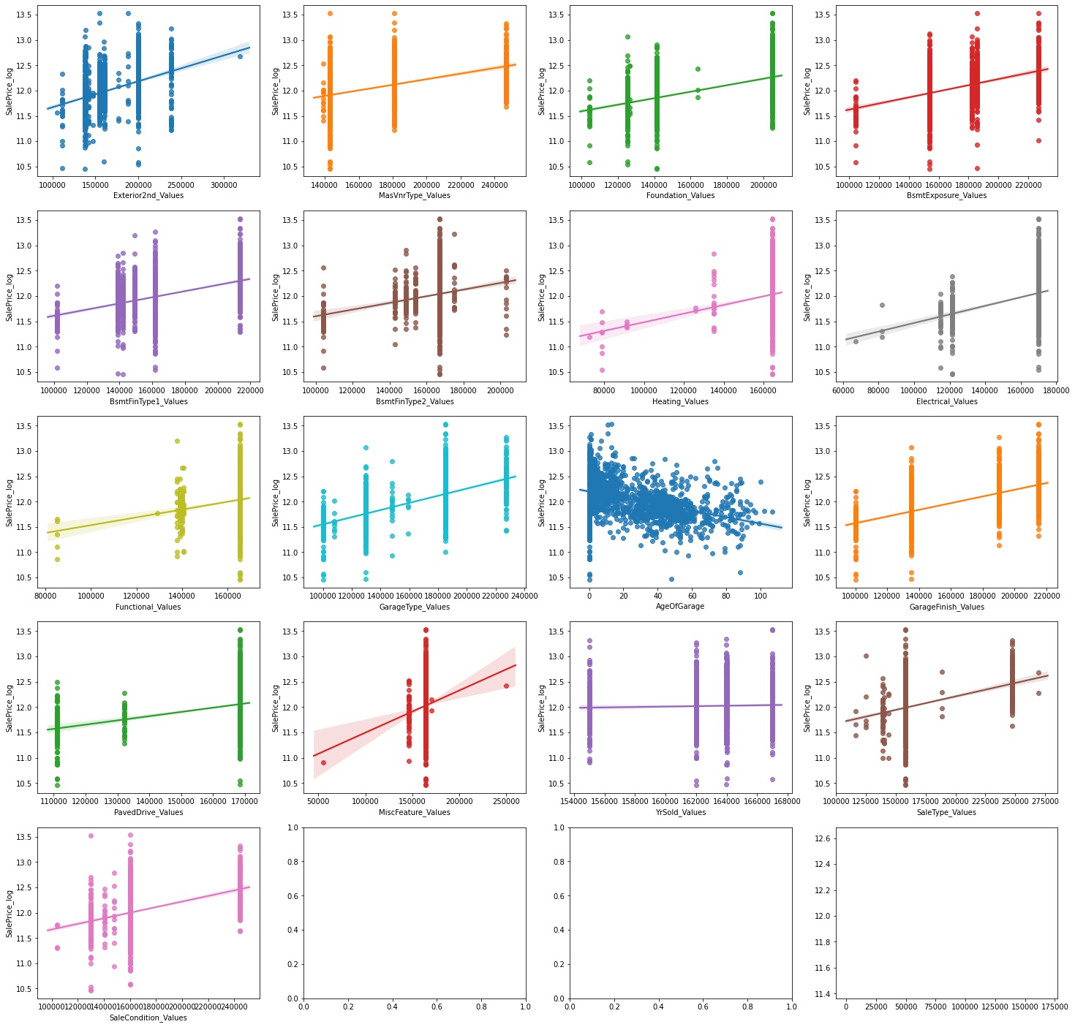

Slide 25
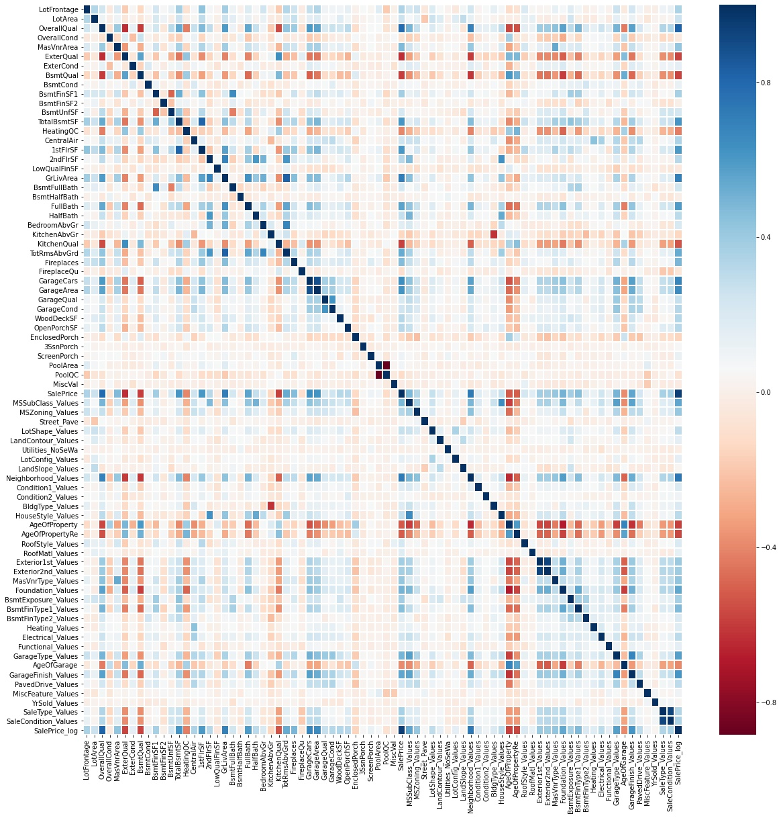

Slide 26
The Explanatory Variables Should not be correlated to each other...

Slide 27
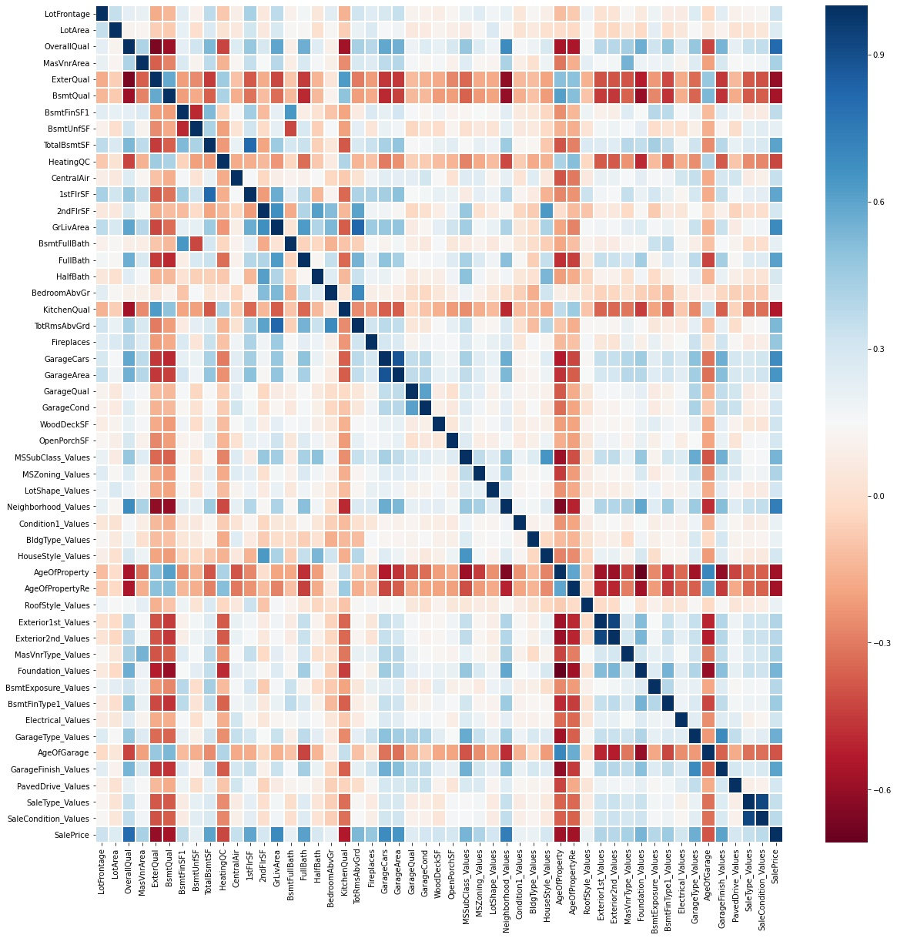

Slide 28
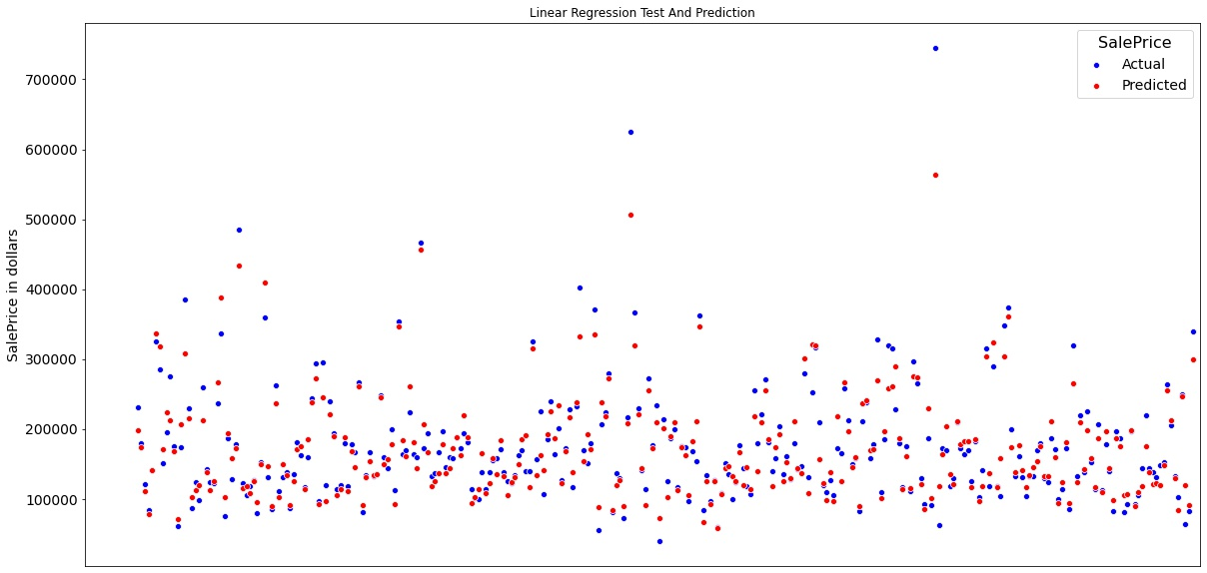
Evaluation of Linear Regression Model
For Train Data
RMSE: 31320.91
R² Value: 83.9%
Adj. R² Value: 83.24%
For Test Data
RMSE: 25910.84
R² Value: 90.59%
Adj. R² Value: 88.82%

Slide 29
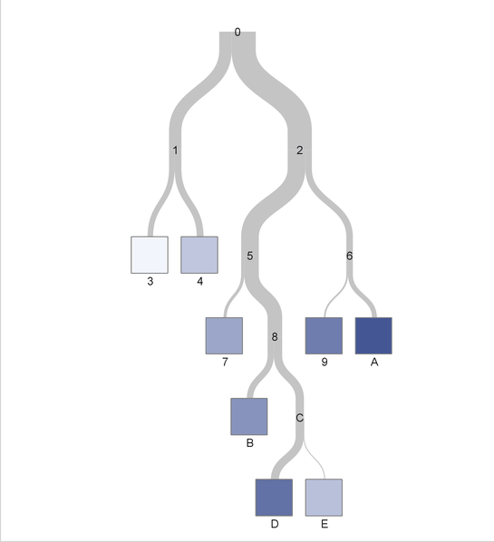
Regression Tree

Slide 30
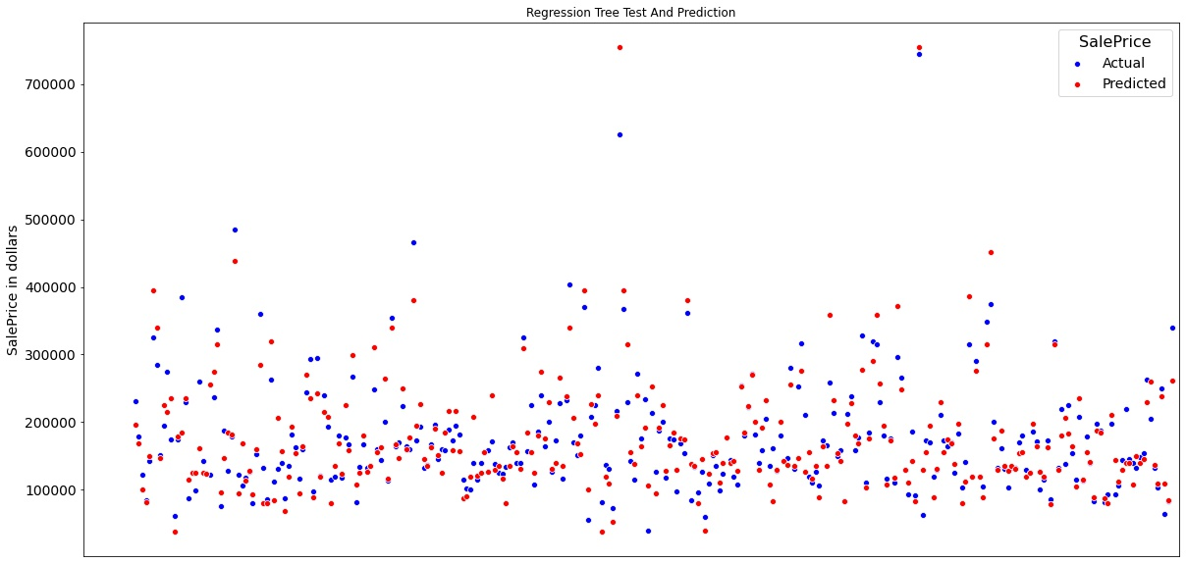
Evaluation of Regression Tree Model
For Train Data
RMSE: 155.18
R² Value: 100%
Adj. R² Value: 100%
For Test Data
RMSE: 35329.27
R² Value: 82.5%
Adj. R² Value: 76.31%
This model is an overfitting model. We will use GridSearchCV to find a better model

Slide 31
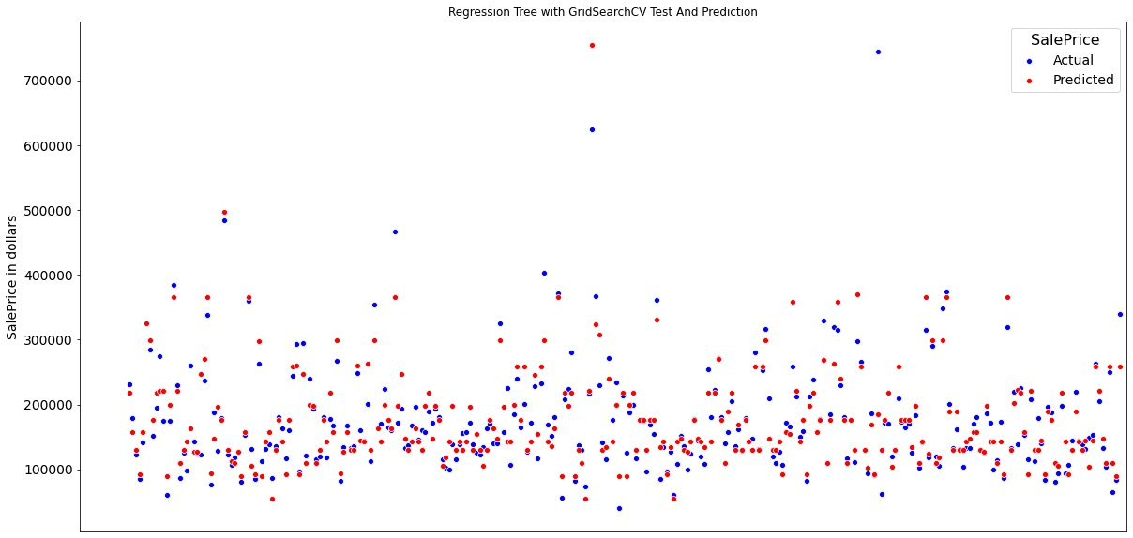
Evaluation of Regression Tree Model with GridSearchCV
For Train Data
RMSE: 19762.77
R² Value: 93.59%
Adj. R² Value: 93.14%
For Test Data
RMSE: 44643.15
R² Value: 72.06%
Adj. R² Value: 62.18%
Best Params
Max_depth: 7
Min_sample_split: 3

Slide 32

Random Forest Regressor

Slide 33
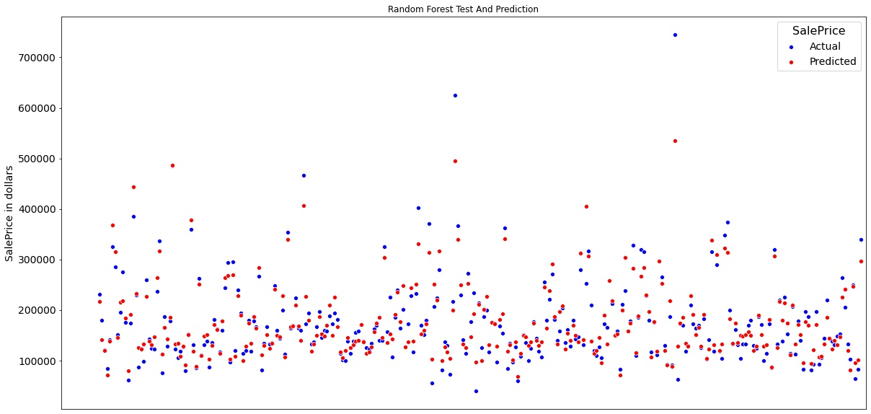
Evaluation of Random Forest Regressor Model
For Train Data
RMSE: 12906.0
R² Value: 97.27%
Adj. R² Value: 97.08%
For Test Data
RMSE: 27922.94
R² Value: 89.07%
Adj. R² Value: 85.2%

Slide 34
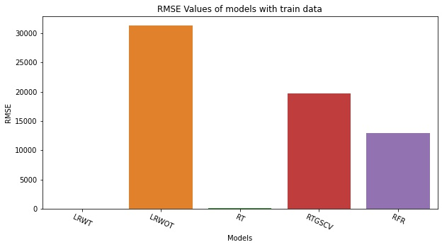
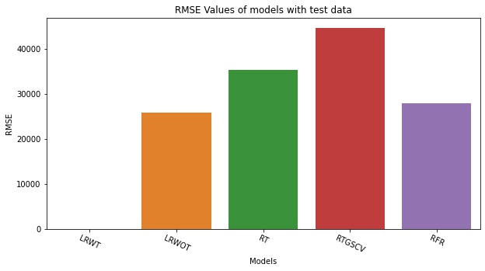
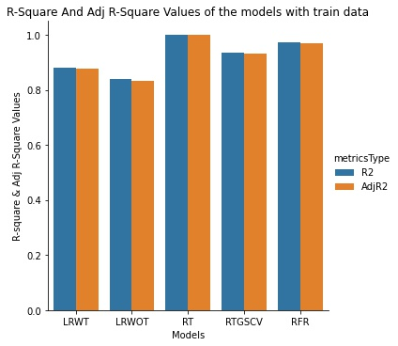
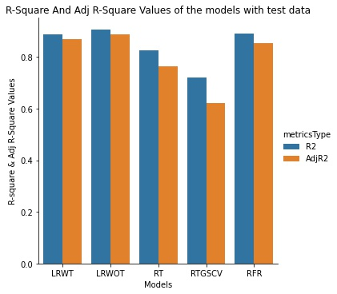
Linear Regression looks to be the best model for prediction

Slide 35


